Slide 1
ACCIDENT RECORD MANAGEMENT SYSTEM

Slide 2
TABLE NAME: ADMIN

Slide 7
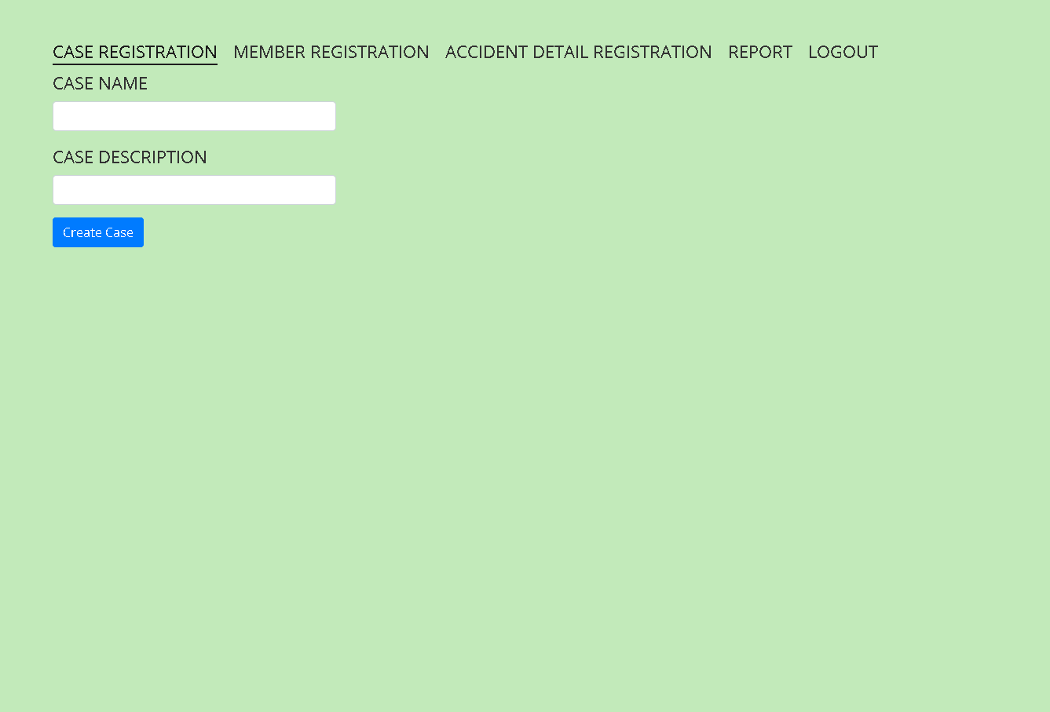

Slide 8
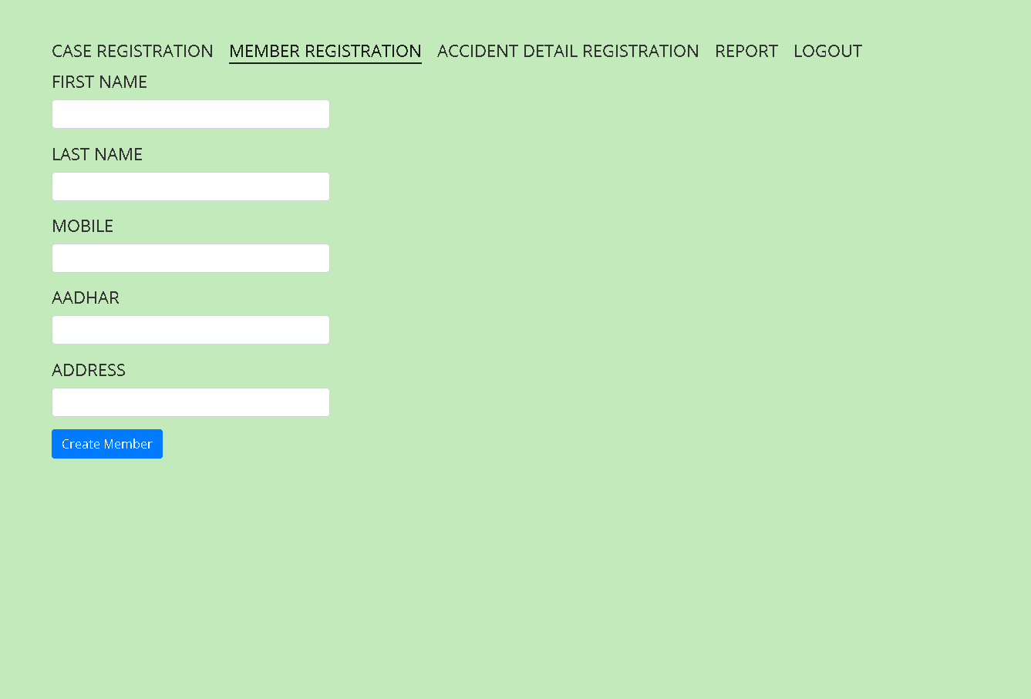

Slide 9
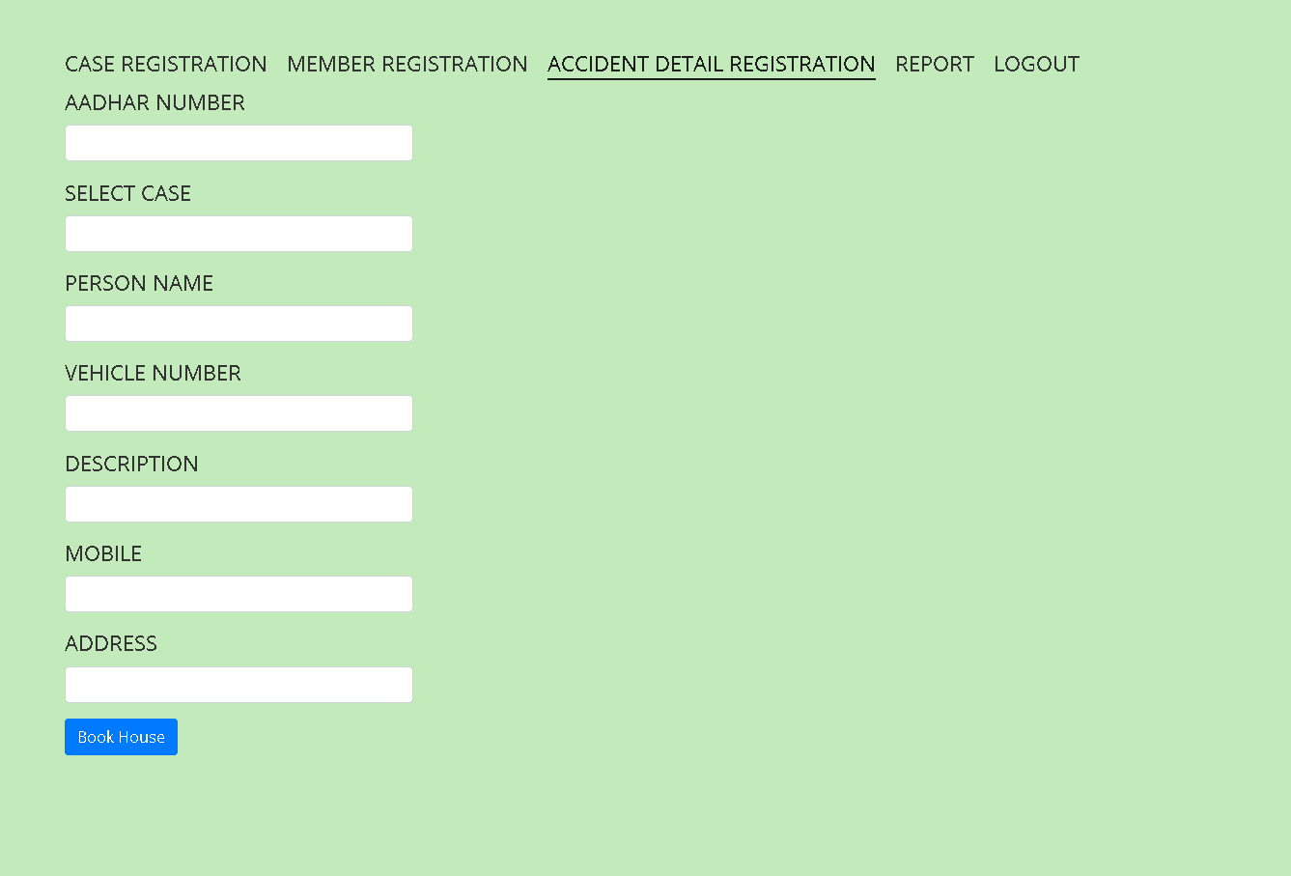

Slide 10
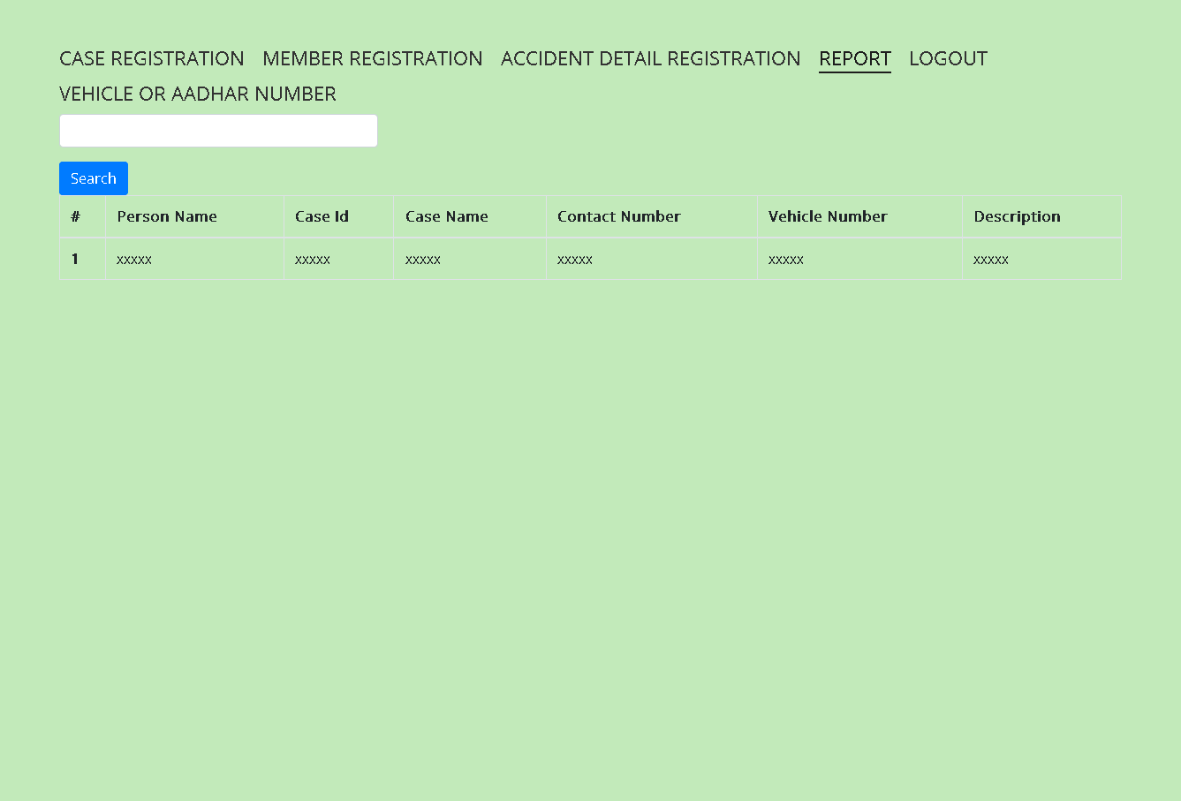

Slide 11
Thank You

